Slide 1
Hochschule Rhein-Waal
Rhine-Waal University of Applied Sciences
Faculty of Communication and Environment
Dr. Svetlana Meißner
Twitter Sentiment Analysis of Donald Trump Tweets Using R and Python
Power Point Presentation
SS 2018
System Simulation
By
Damian Anamelechi Anyamele
Matriculation Number:
15748

Slide 2
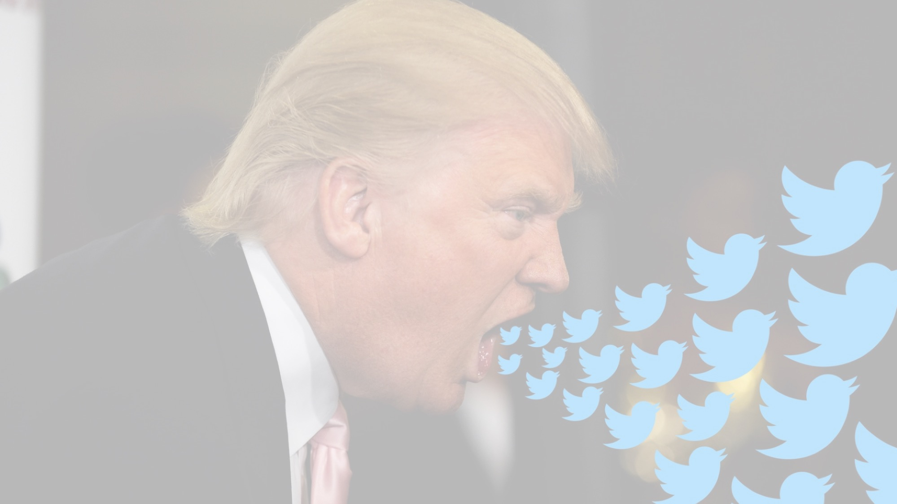
Content
Problem statement
Tools and Dataset Description
Result and Visualization
Link to the research work’s artifacts

Slide 3
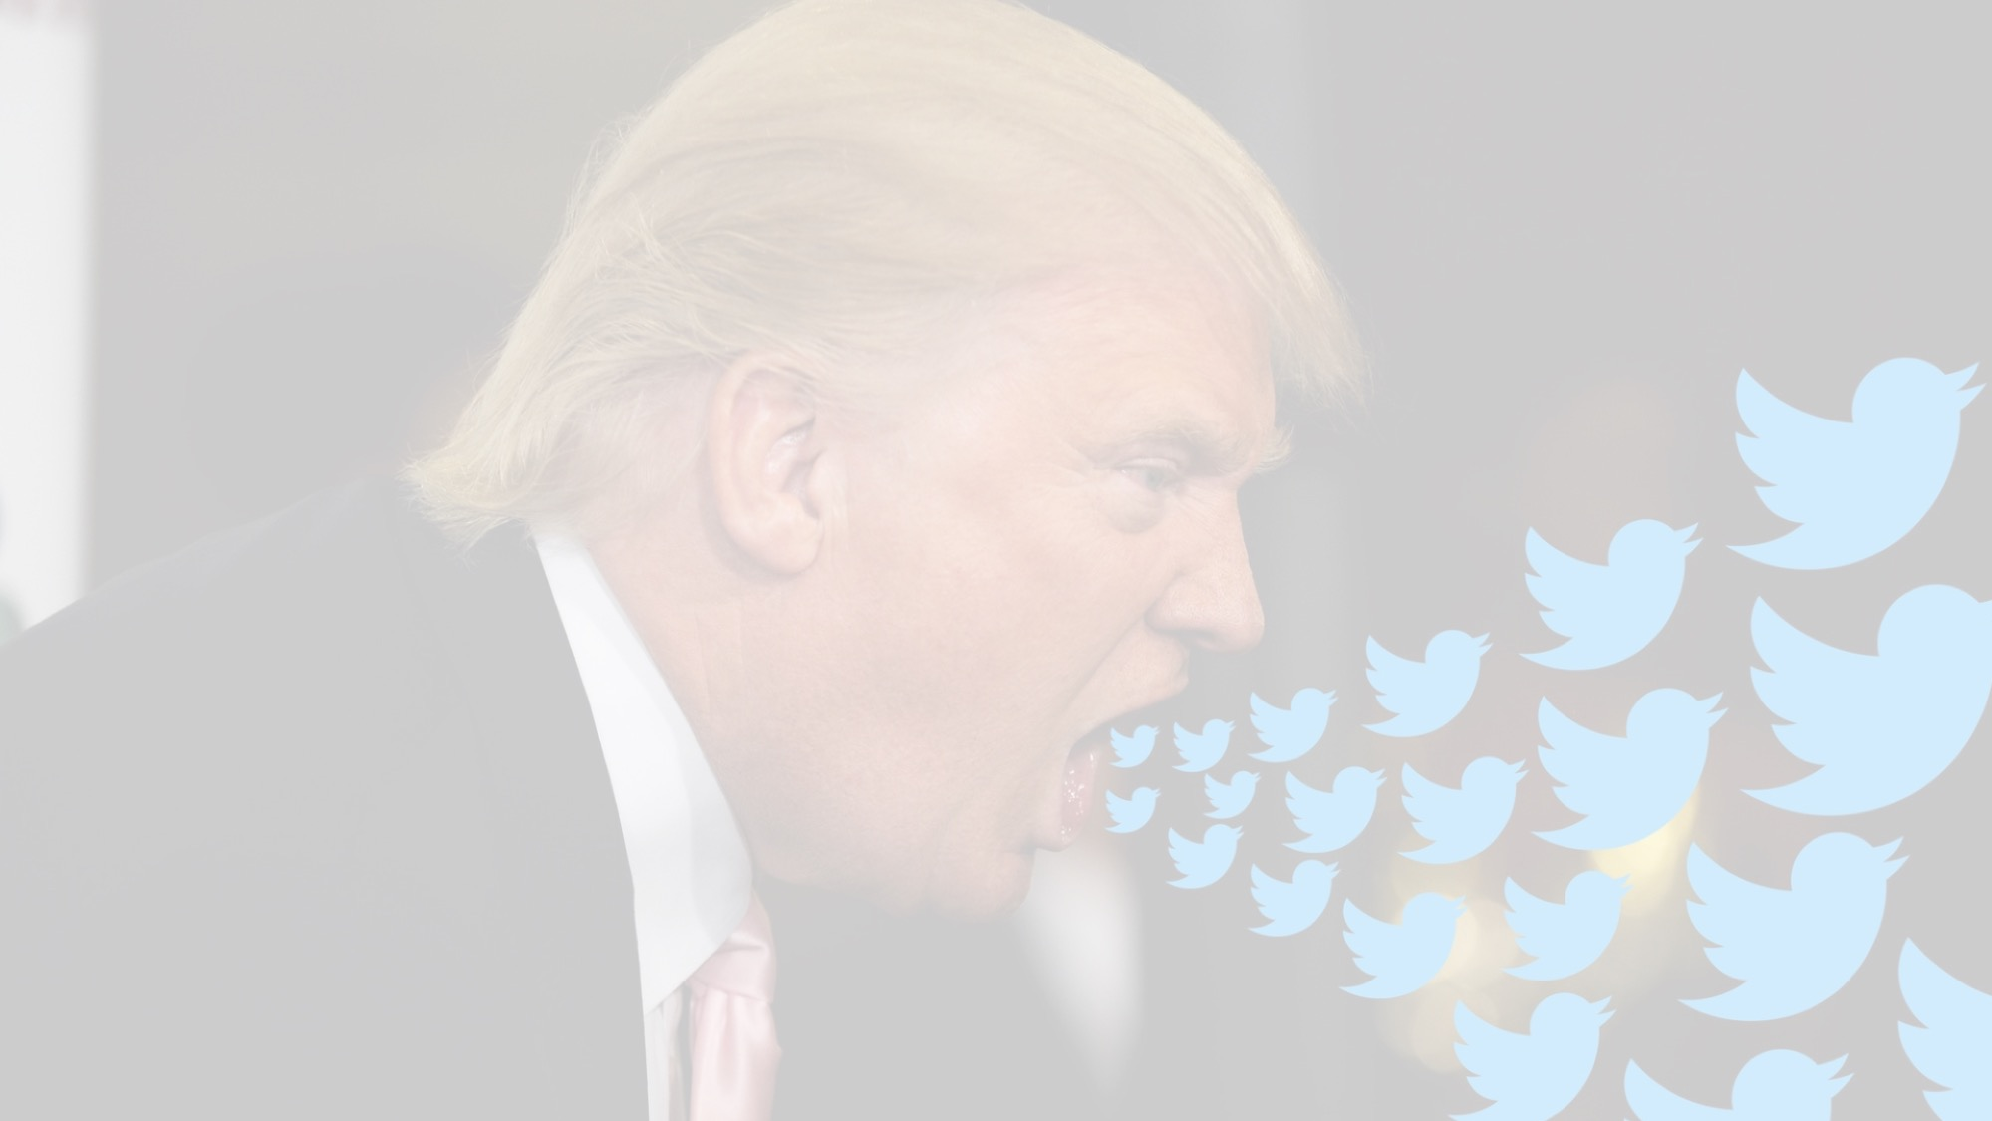
Problem Statement
Trump has been accused to be a narcissist, many hold him responsible for instigating hate, fear, anger in today American society and has initiated distrust and resentment towards the media under his leadership.
This analysis intends to use president Trump twitter post to trace the fact and the truth.

Slide 4
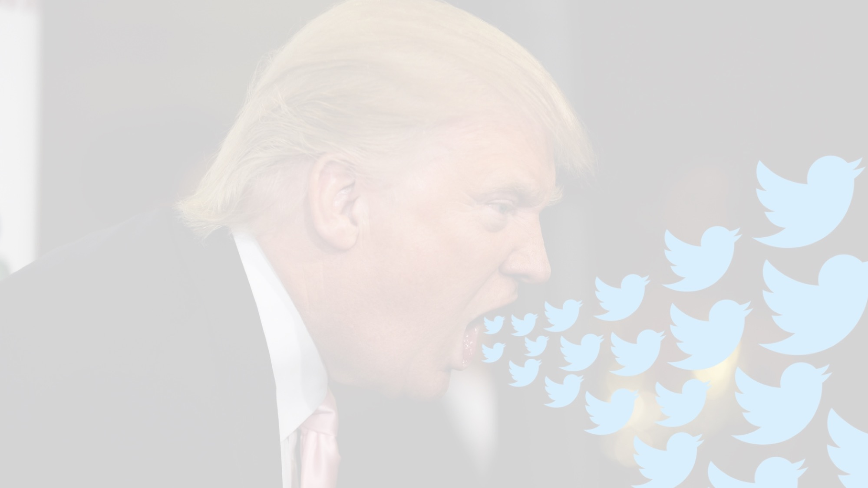
Tools and Dataset
Tools
R studio
Loaded package: tm, syuzhet package, wordcloud, Sentiment
Algorithm: Naïve Bayesian Classifier
Python- Spyder, then Jupyter notebook for Visualization
Loaded package: NLTK
Dataset
This include Trump twitter post with respect to different domain over
several years (2015 – 2018)

Slide 5
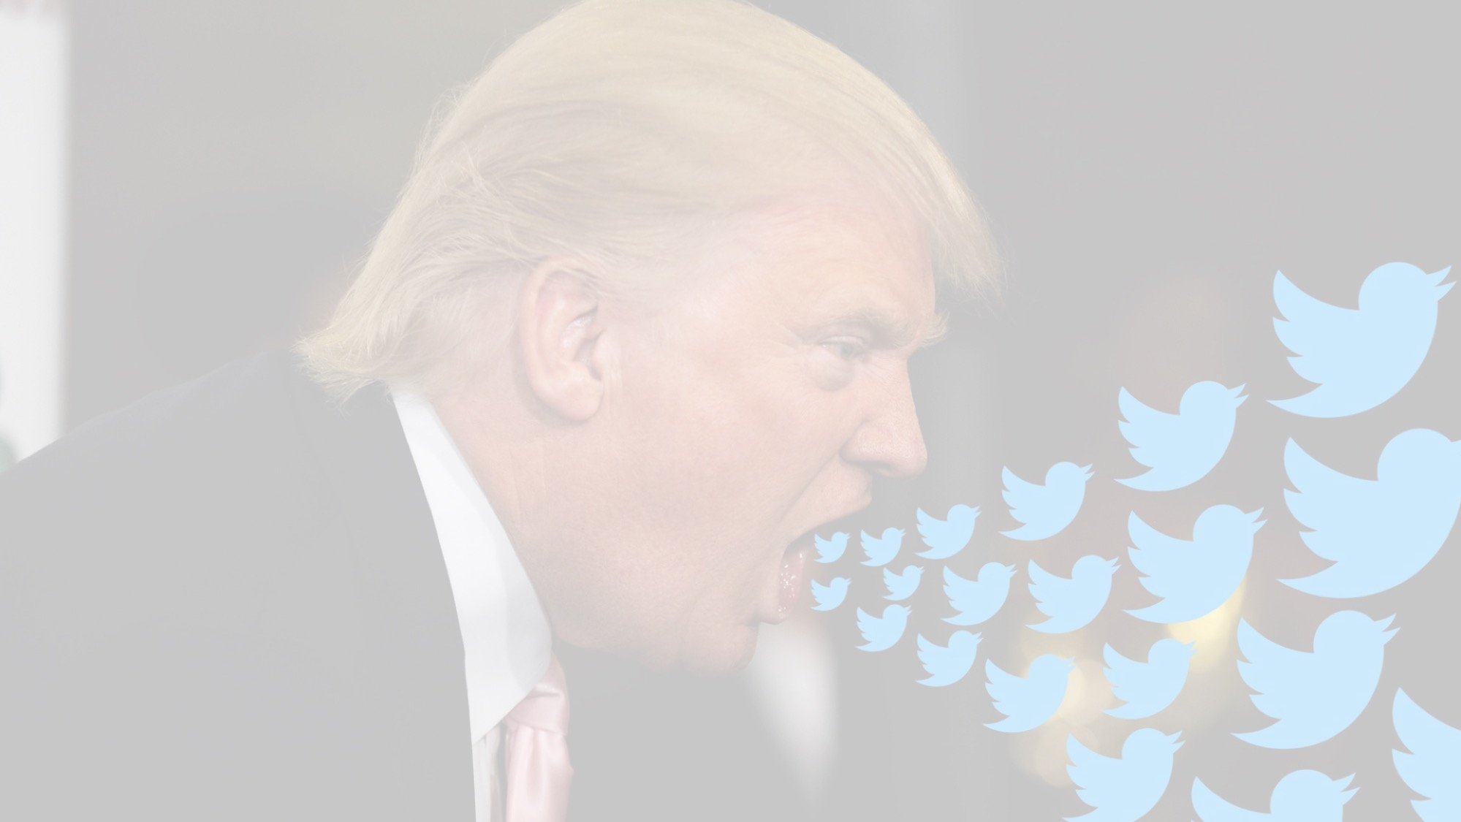
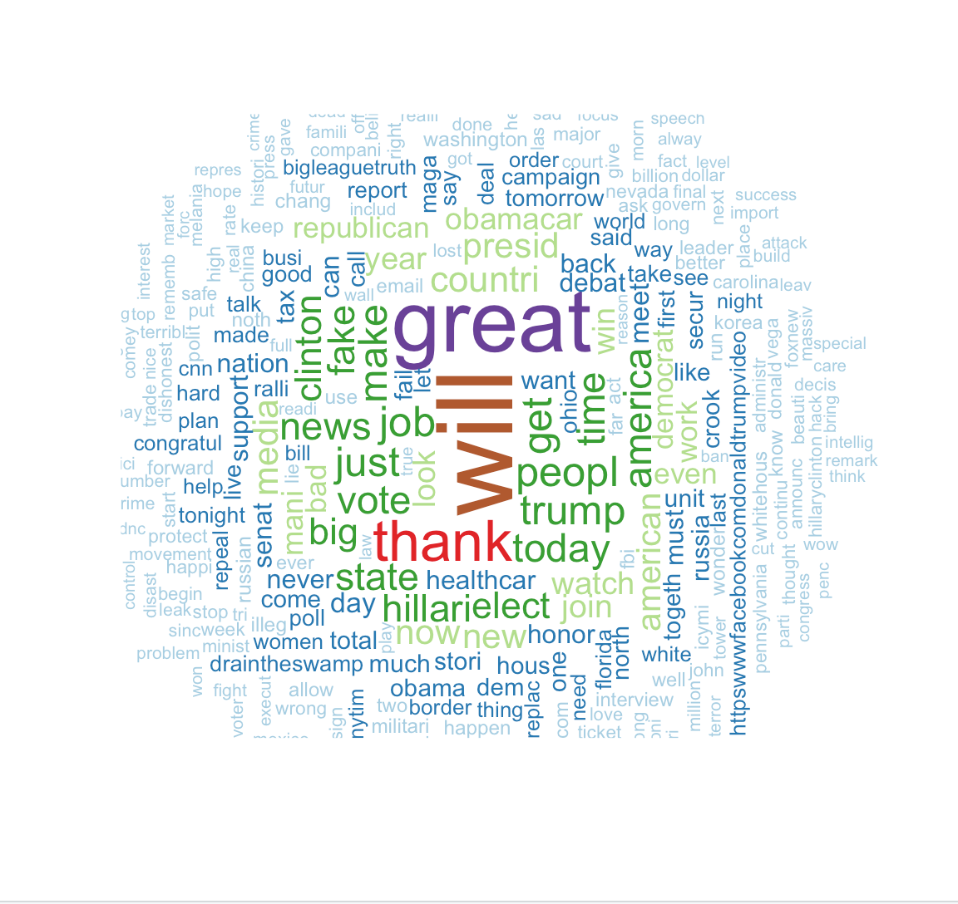
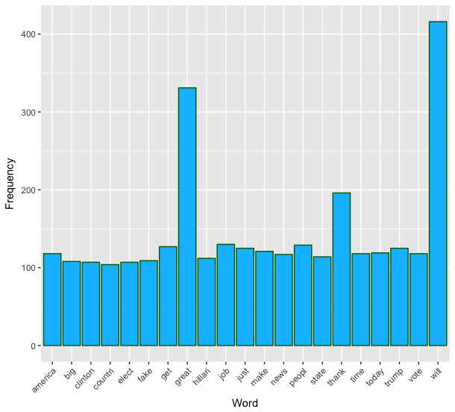
Result and Visualization
Word cloud and a bar chart showing the most frequent used word in Trump’s tweets post

Slide 6
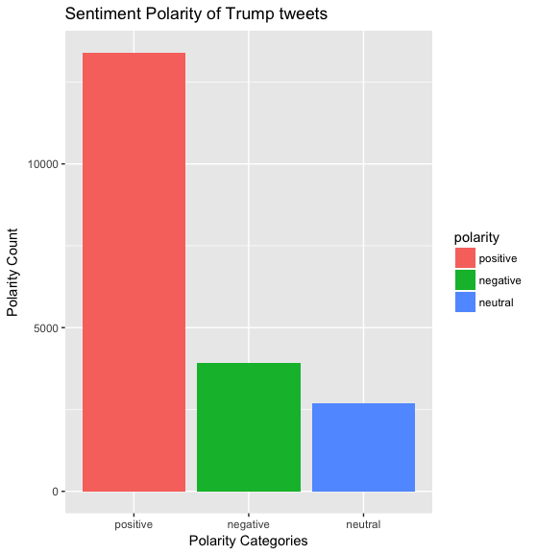
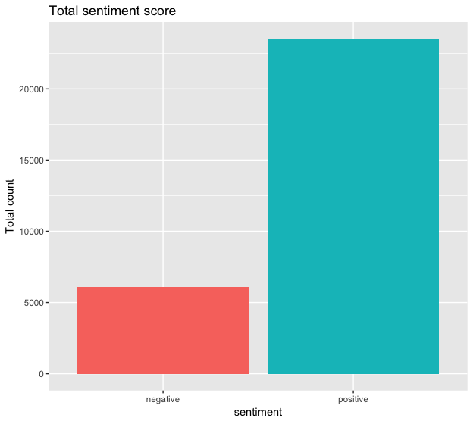
Result and Visualization: Polarity
Polarity classification of Trump‘s tweet using Bayes algorithm
Emotion classification of Trump‘s tweet
using Syuzhet

Slide 7

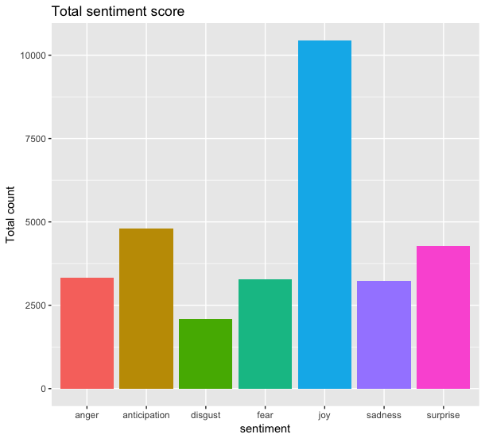
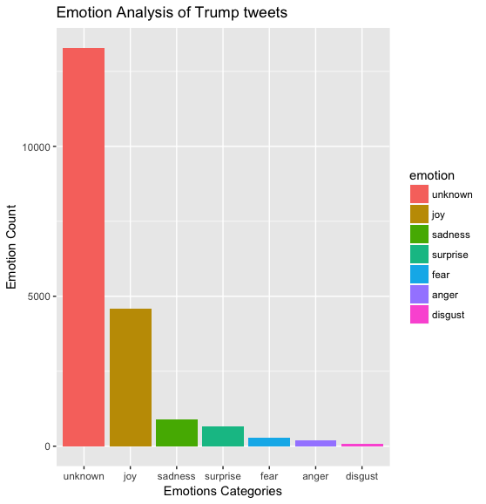
Result and Visualization: Emotion
Emotion classification of Trump‘s post
using Syuzhet
Emotion classification of Trump‘s post
using Bayes algorithm

Slide 8
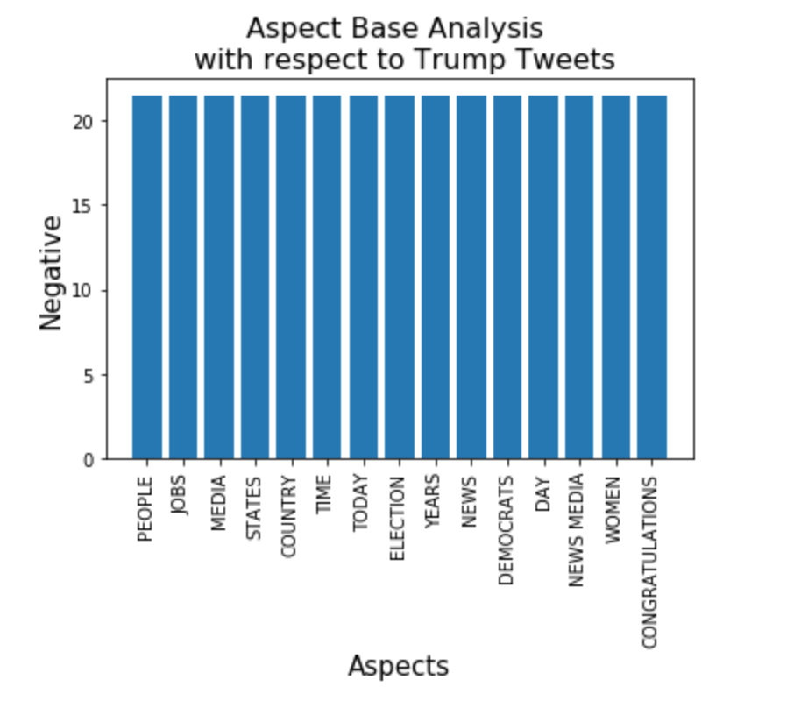
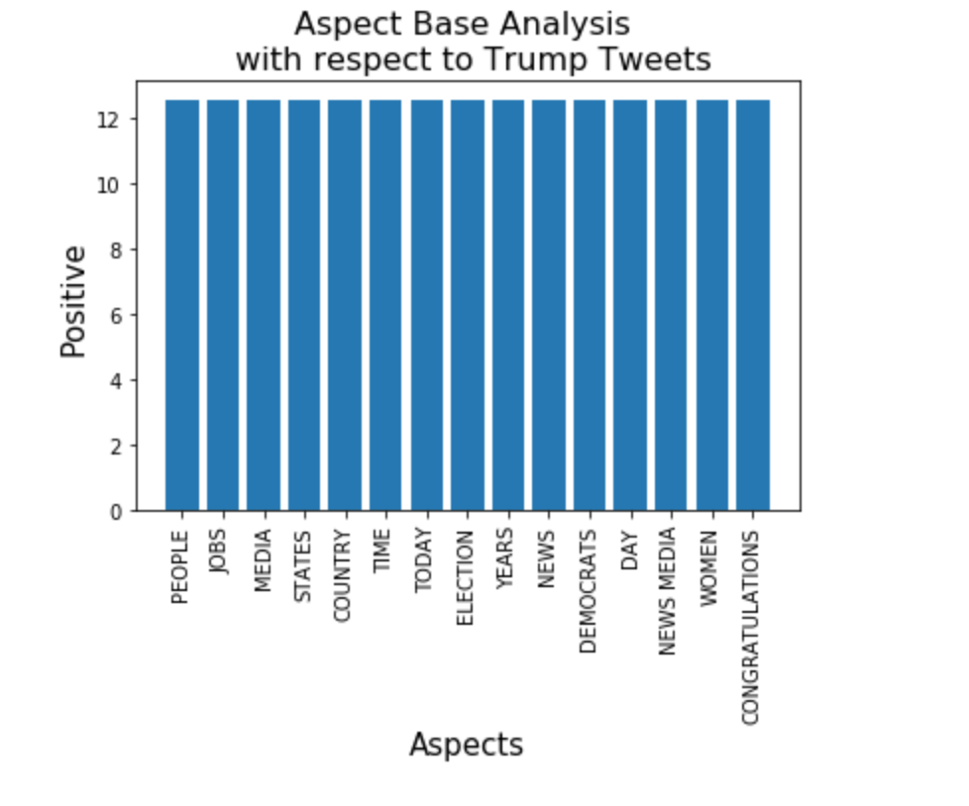
Aspect Base Sentiment Analysis
Negative score of 24.45
Positive score of 12.56
The blue cycle represent our are of Interest (The Media)

Slide 9
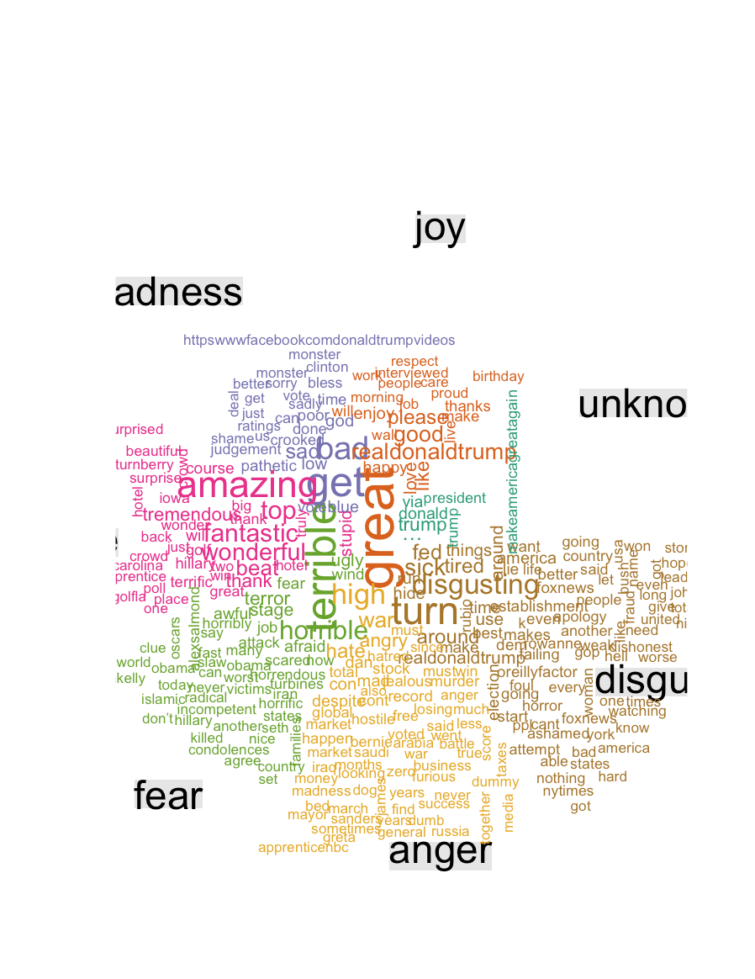
Result and Visualization
Matching the used words to the emotion they expressed
Example-Disgusting: Fox news, dishonest, foul, horrible

Slide 10
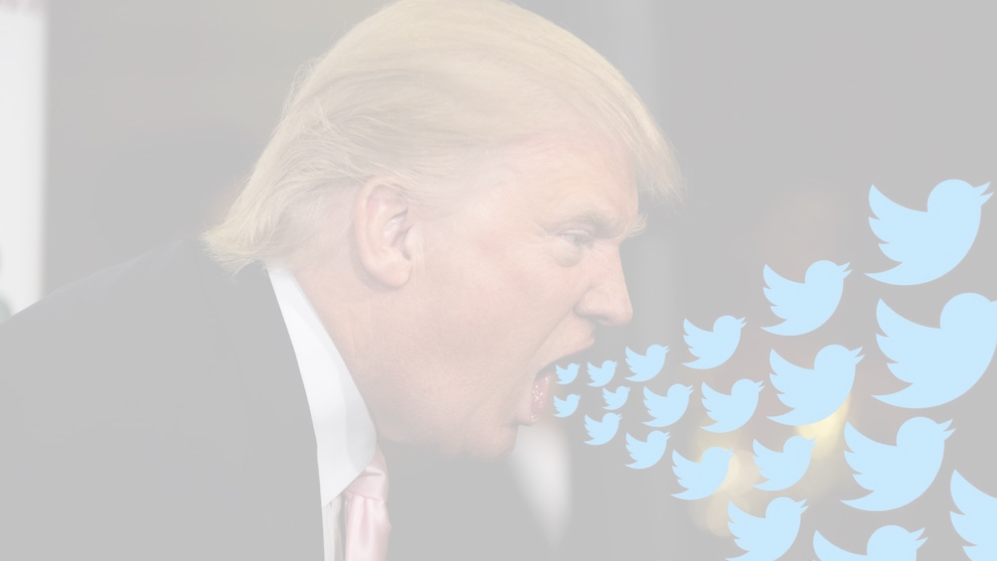
Conclusion
A narcissist is a person who has an excessive interest in or admiration of themselves.
Trace of this personality disorder was found in the tweet post analysis of Trump
Insinuating lack of honesty of the media in dealing with the truth.
However the analysis could not prove of Trump responsible of instigating hate or fear among American citizens

Slide 11
References
Trump Twitter Archive, Available from: < http://www.trumptwitterarchive.com> [Accessed 25 June 2018]
Project Link
This link provides access to the codes, dataset used and the result outcome of the project [Right click here, go to hyperlink then click open hyperlink]

